Slide 1
Java OOP 2D Box Pushing Game Code Analysis.
new String[]{ 王俊崴，胡哲玮，何远嵚， 赵亮哲 }

Slide 2
TABLE OF CONTENTS.
01
02
03
04
05
06
Analysis of voted “best” code
最好的代码的分析介绍
Code strengths and weaknesses
代码的优点和不足
Code with most room for improvement
改进余地⽐较⼤的代码
Comparison
改进完的代码前后对比
Lab[n] => Lab[n+1]
Q & A

Slide 3
Analysis of voted “Best” code
01
<p> For a beginner in Java, it's important to understand and apply Object-Oriented Programming (OOP) concepts such as encapsulation, inheritance, and polymorphism, which will help you write more organized, reusable, and flexible code.</p>
― ChatGPT

Slide 4
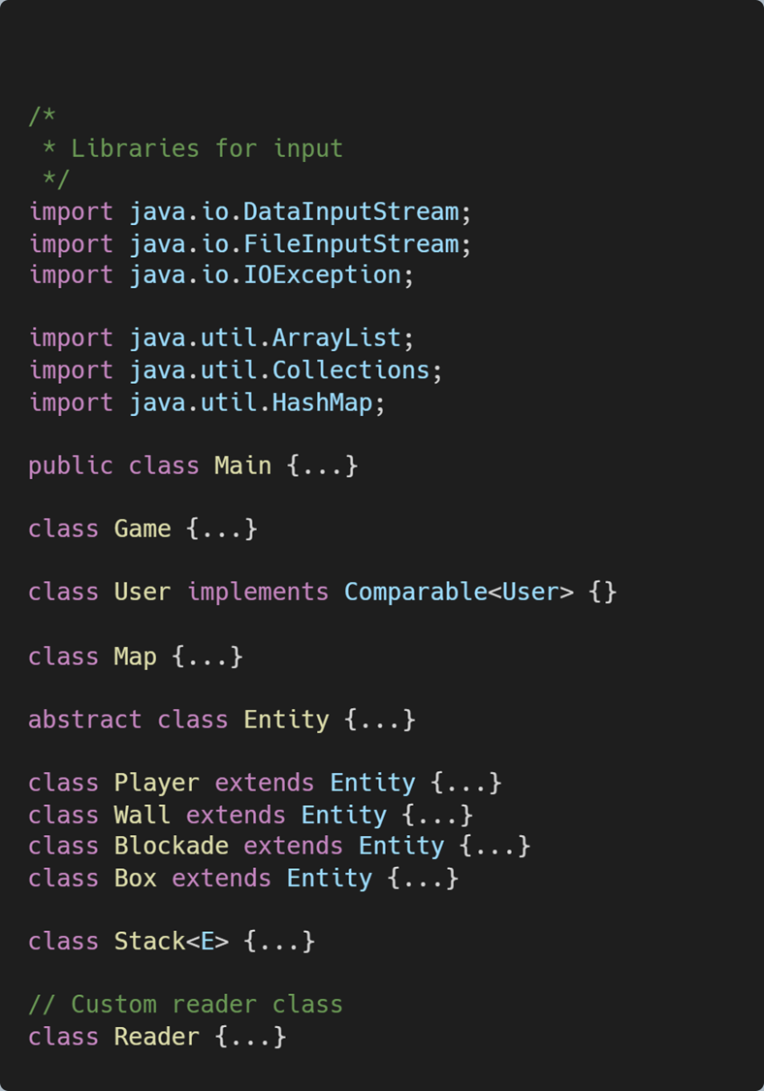
Overall Structure.

Slide 5
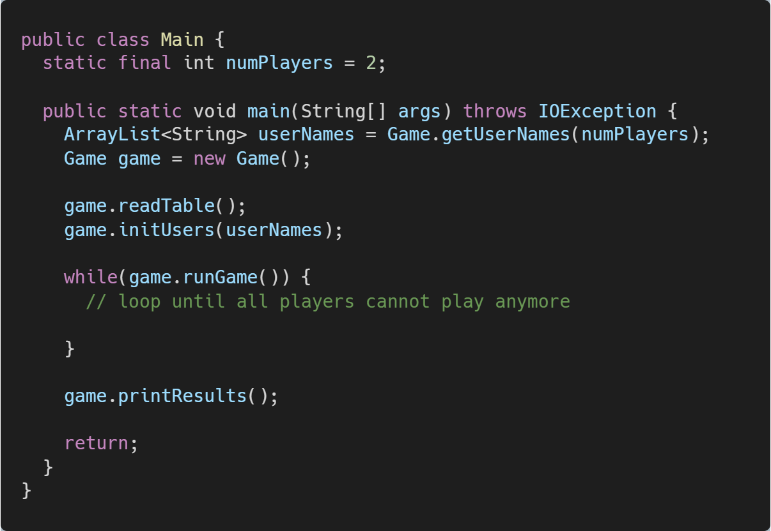

Slide 6
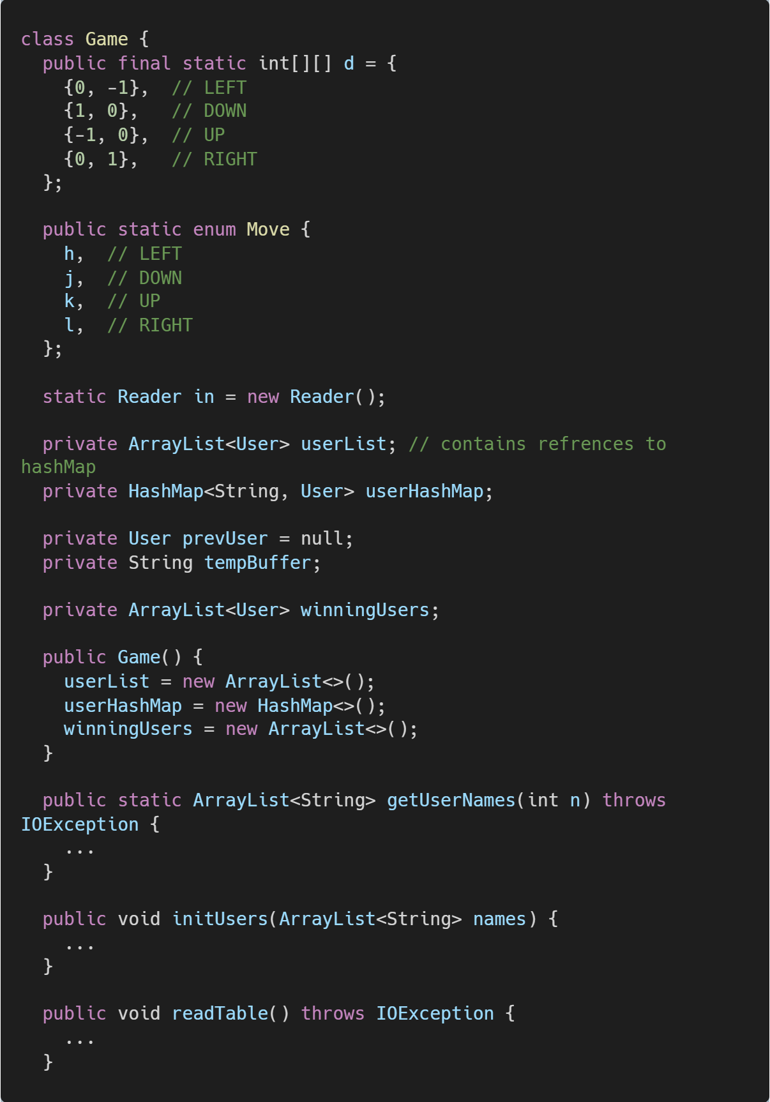
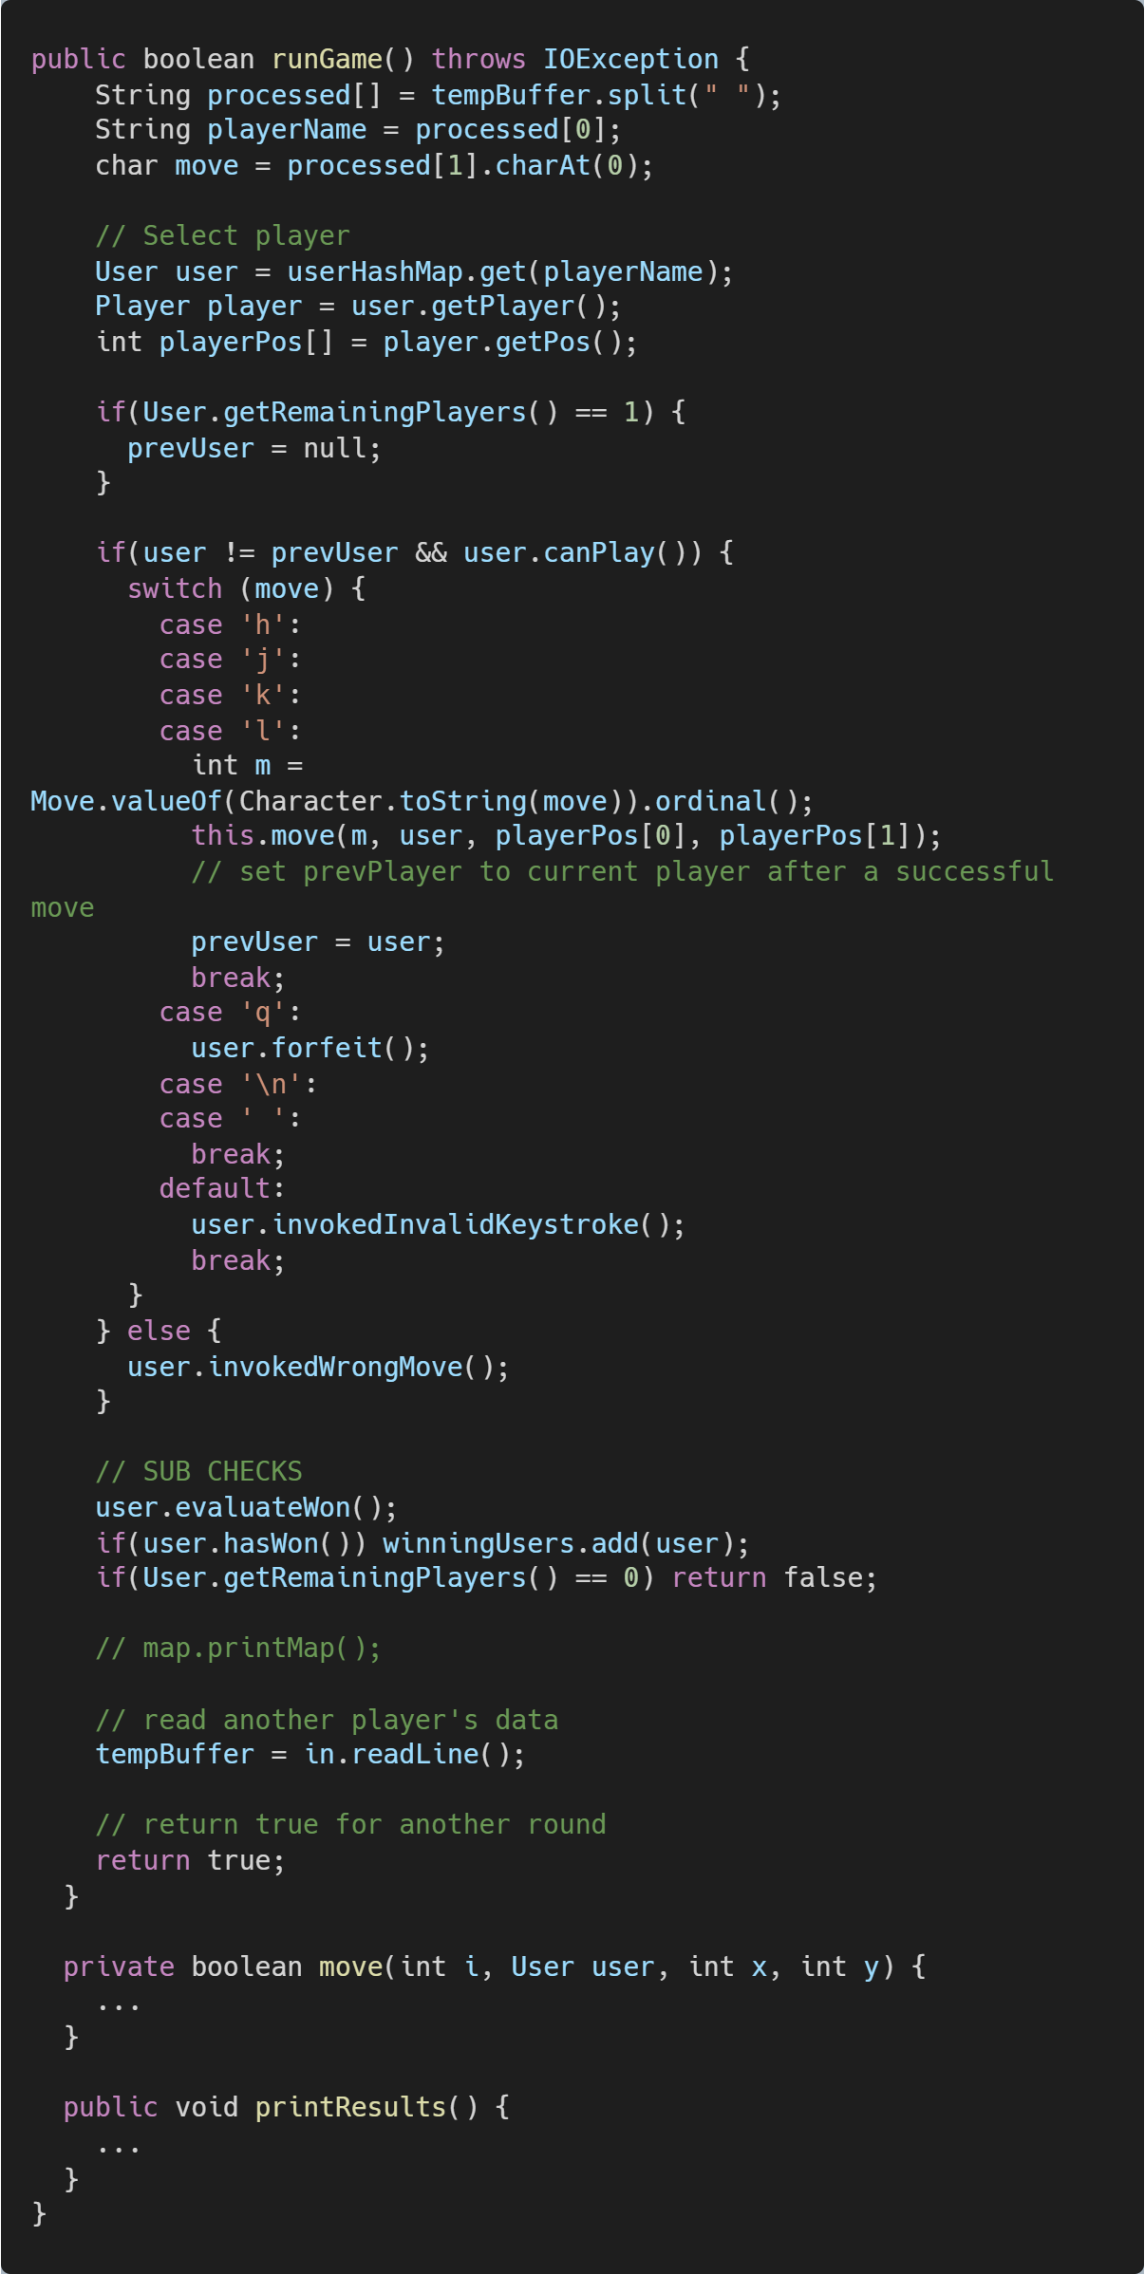

Slide 7
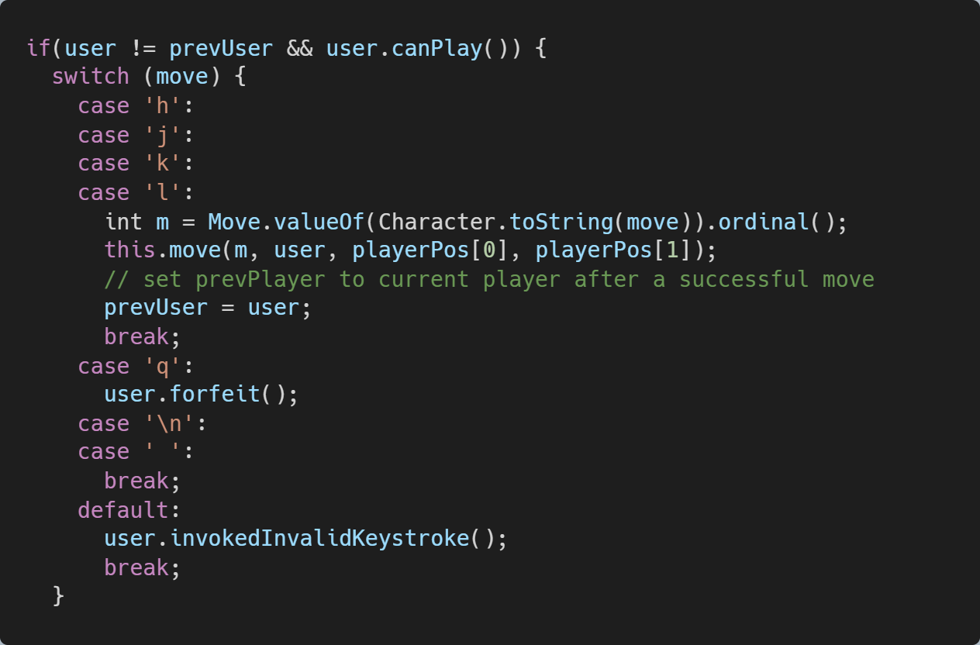

Slide 9
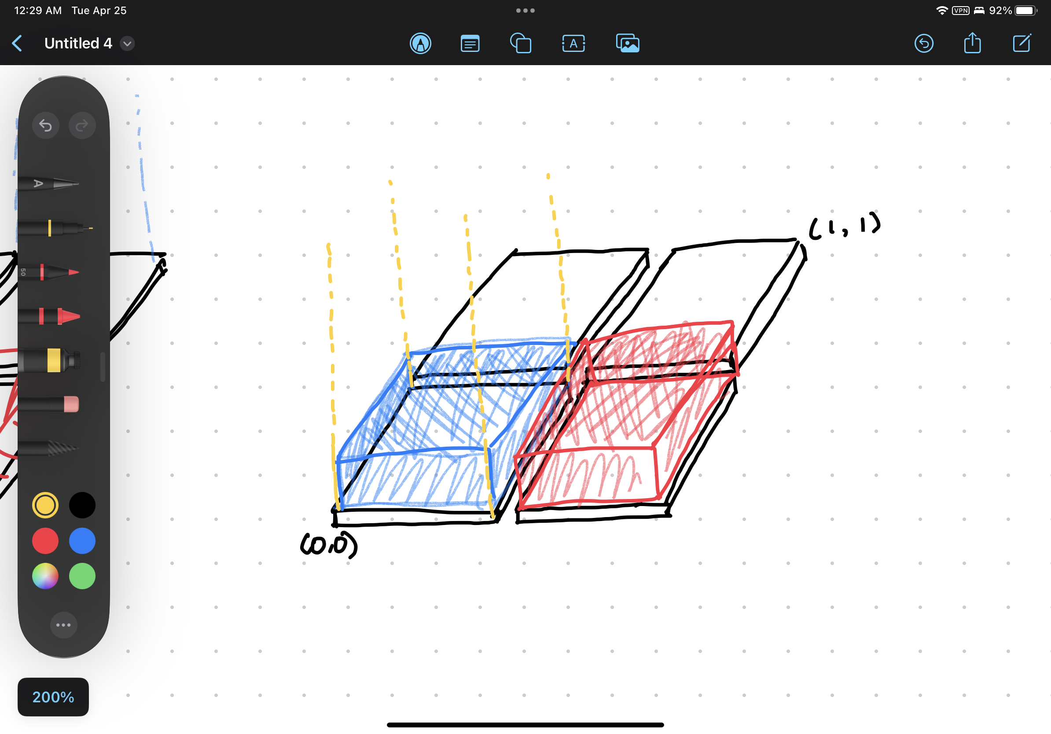
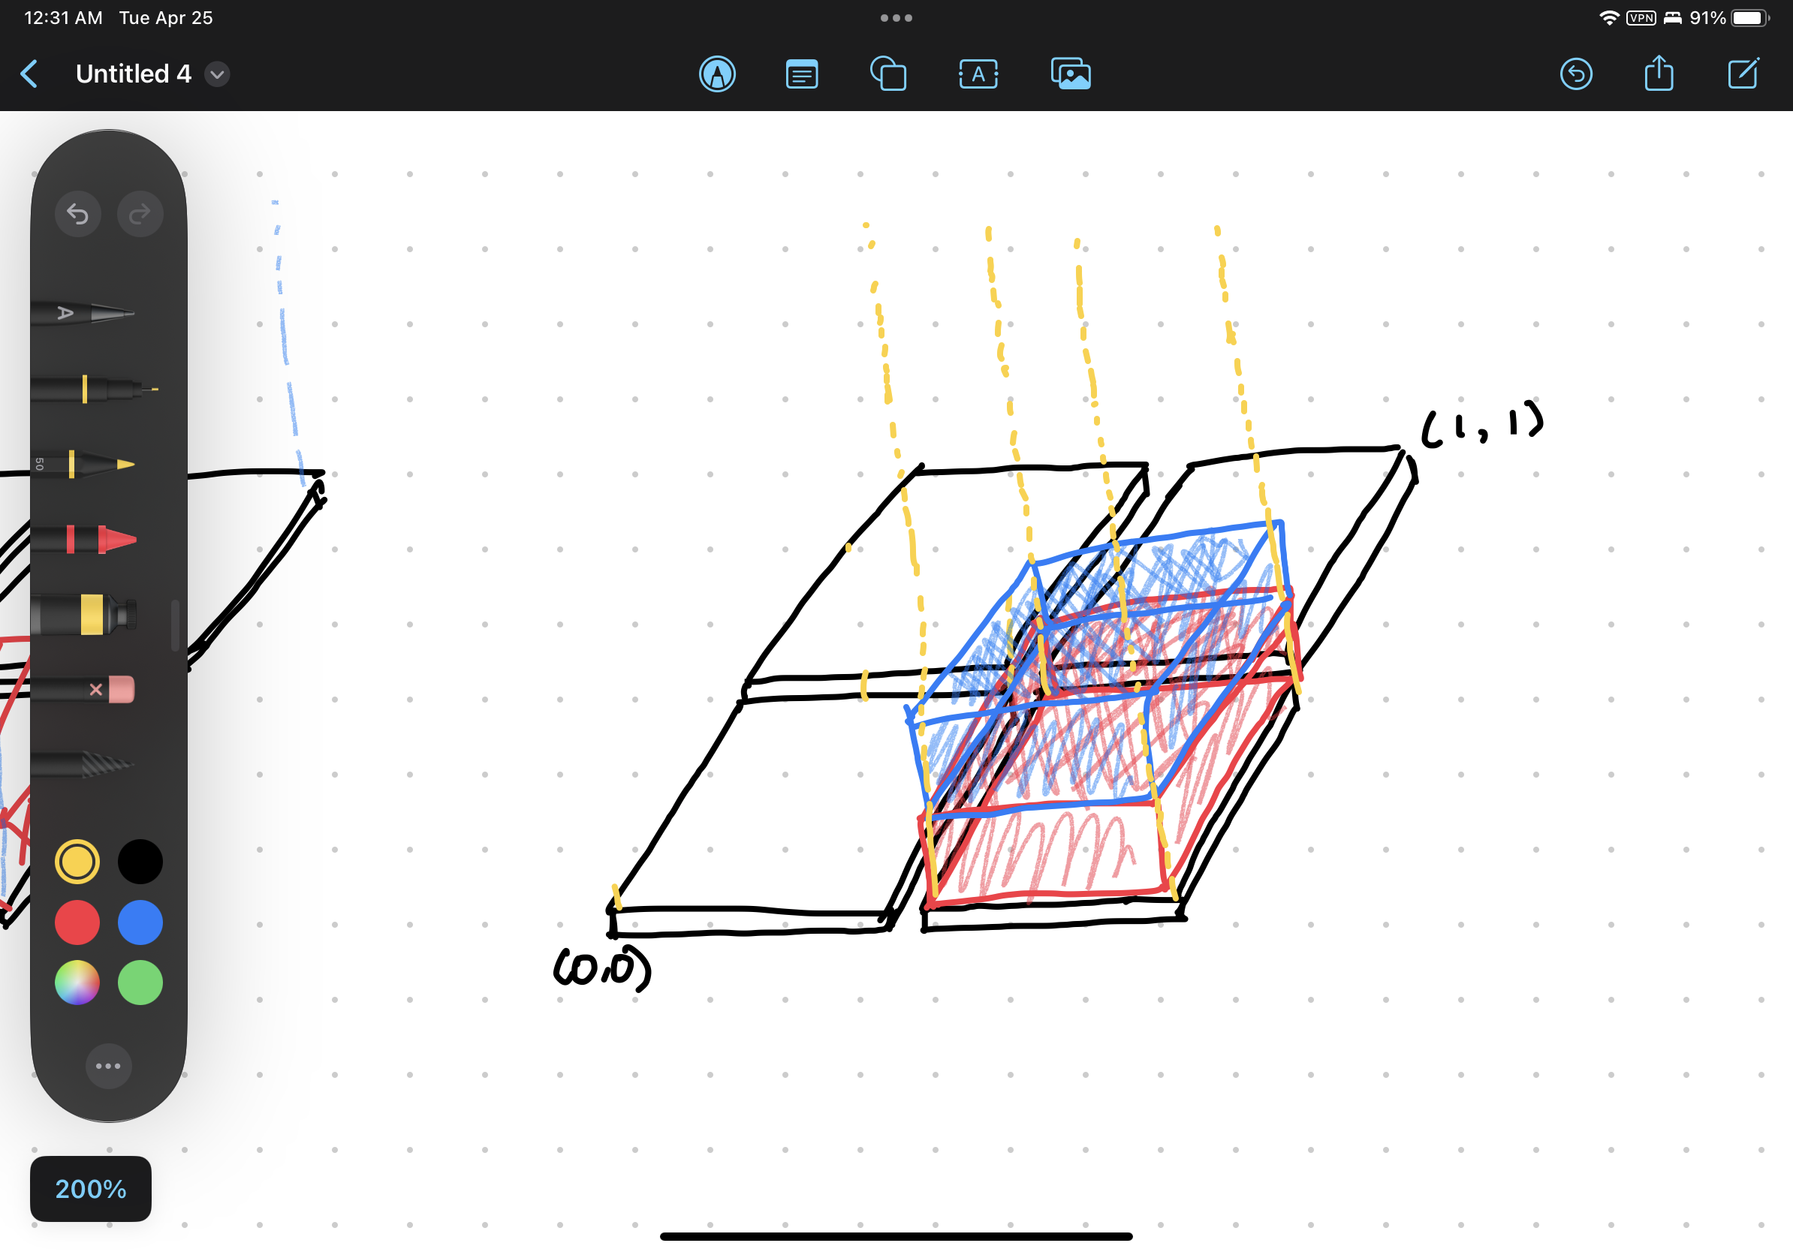
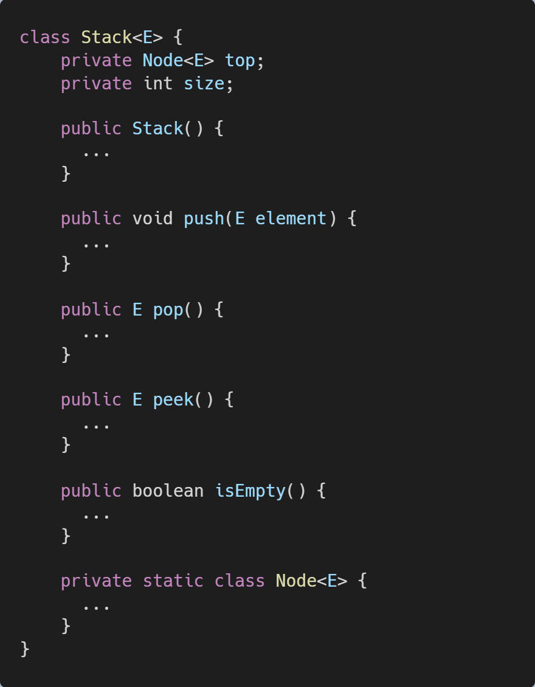
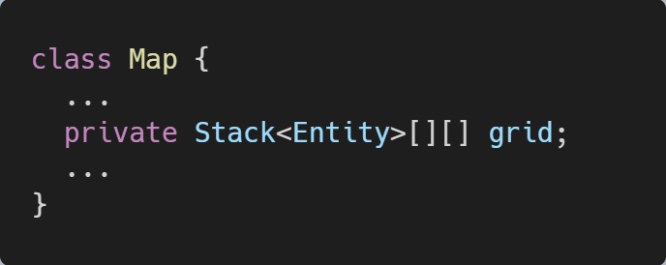
2D grid array of stacks anyone?

Slide 10
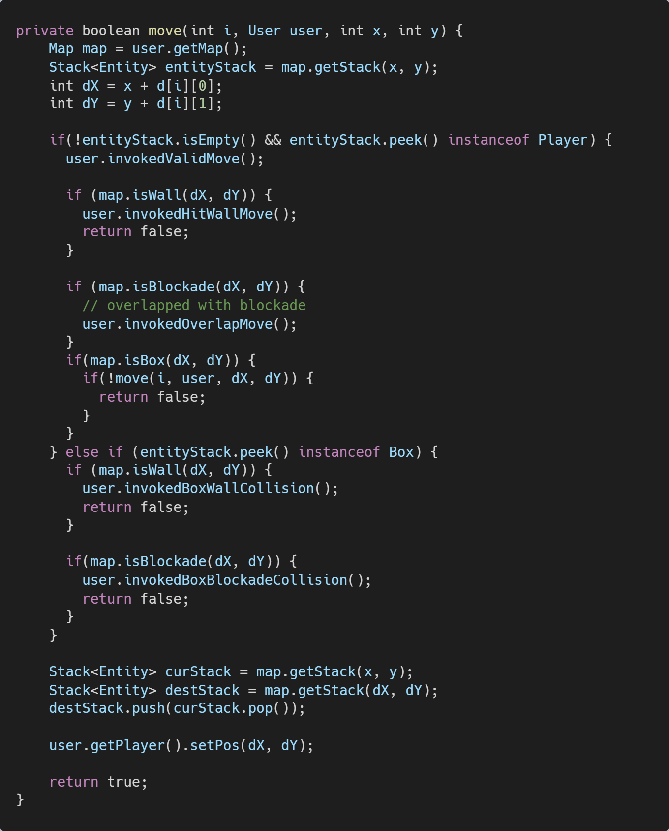
How is the stack used?

Slide 11
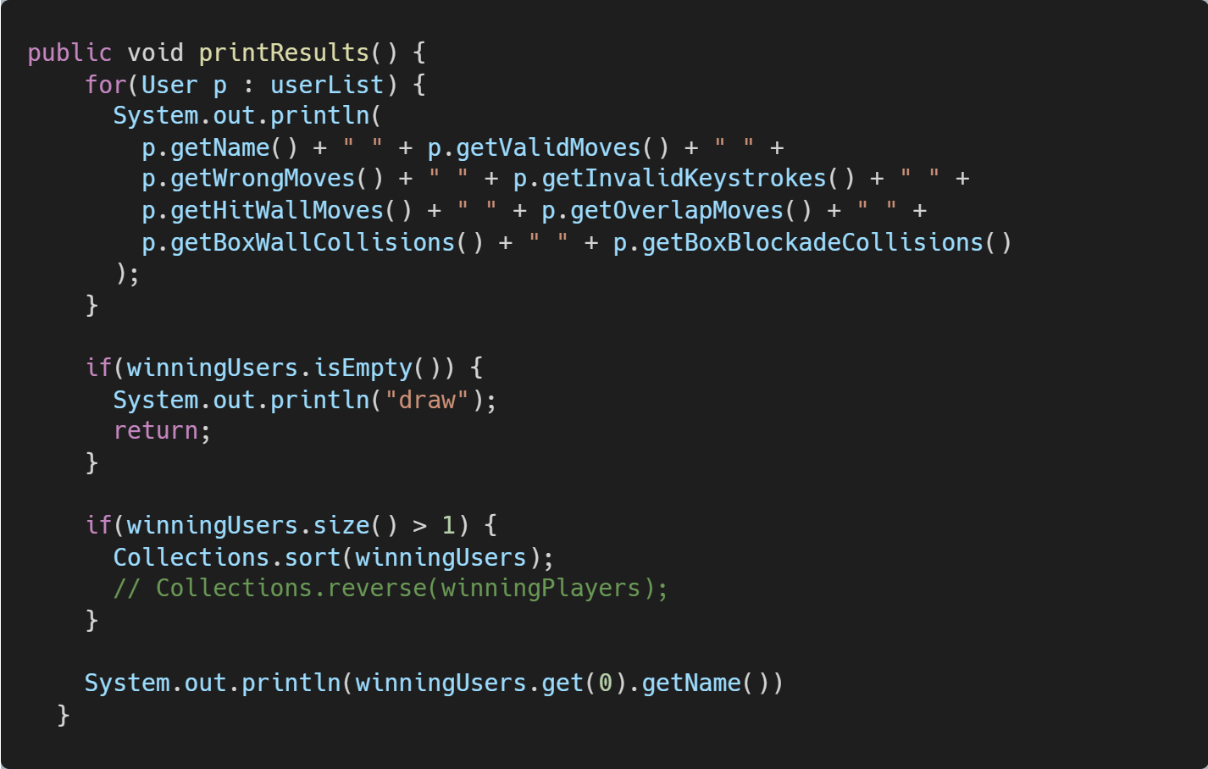
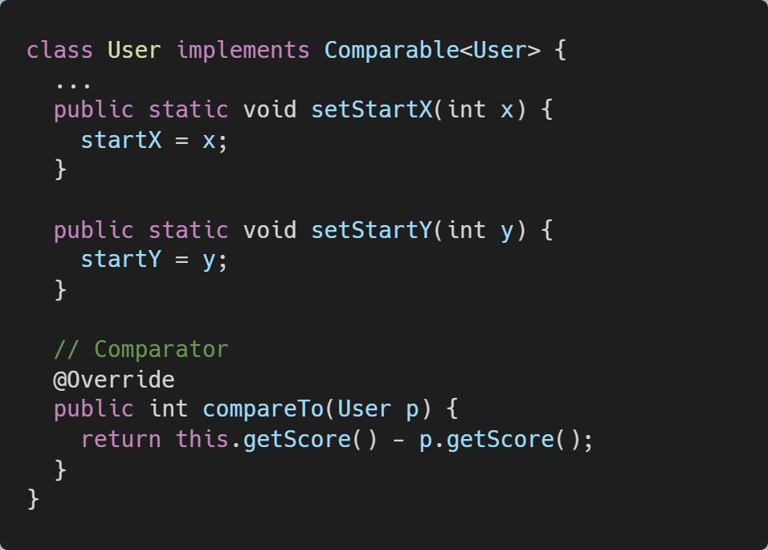
Comparable & @Override

Slide 12
Code Strengths and Weaknesses
02
While writing Java code, pay attention to the SOLID design principles to ensure your code is robust, maintainable, and extensible, thus improving overall code quality.
- ChatGPT

Slide 13
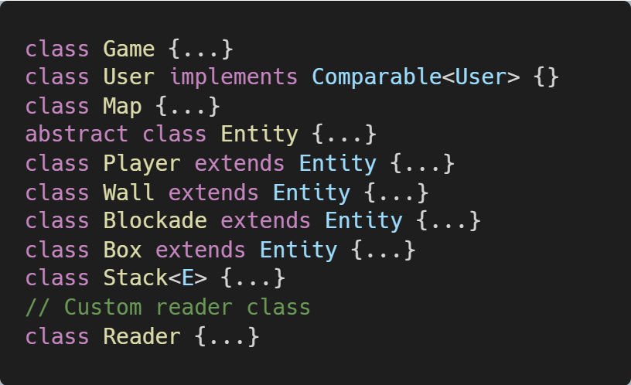
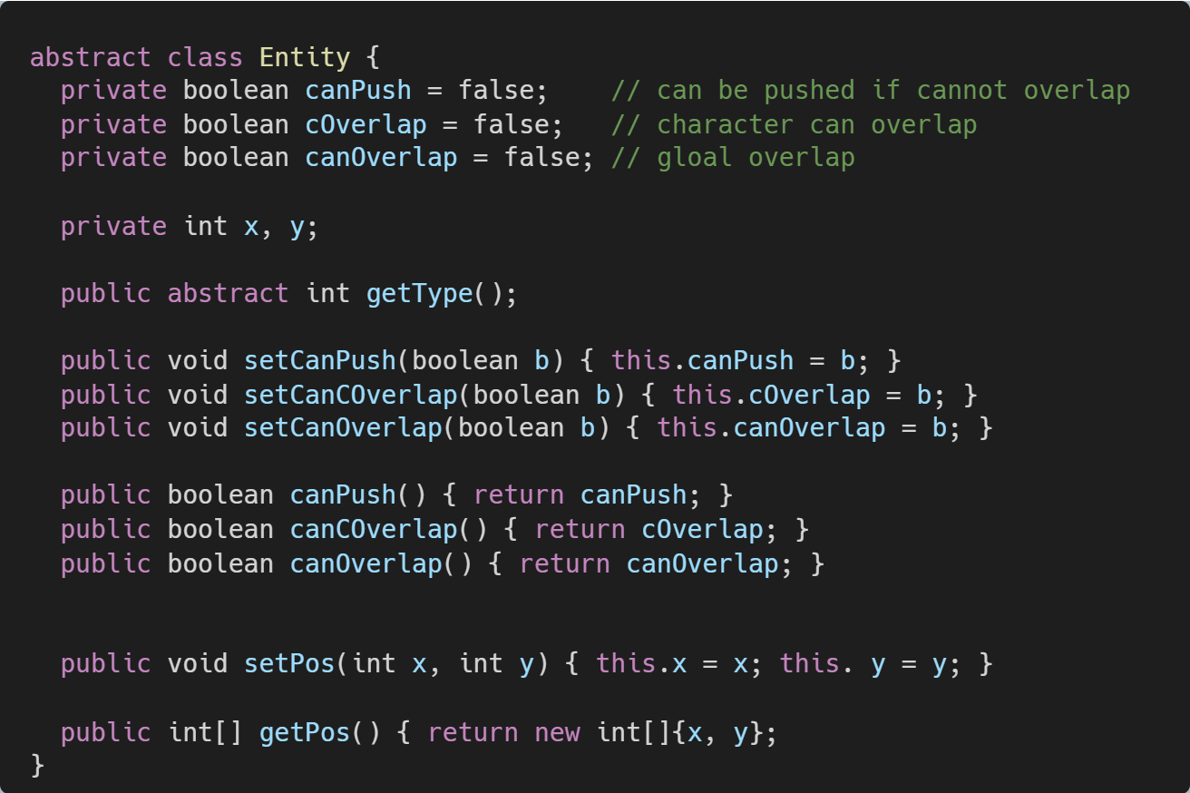
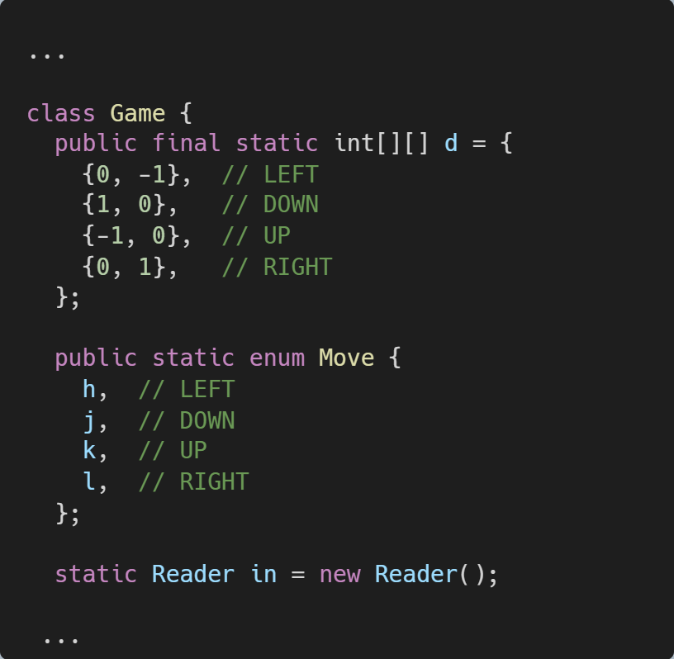
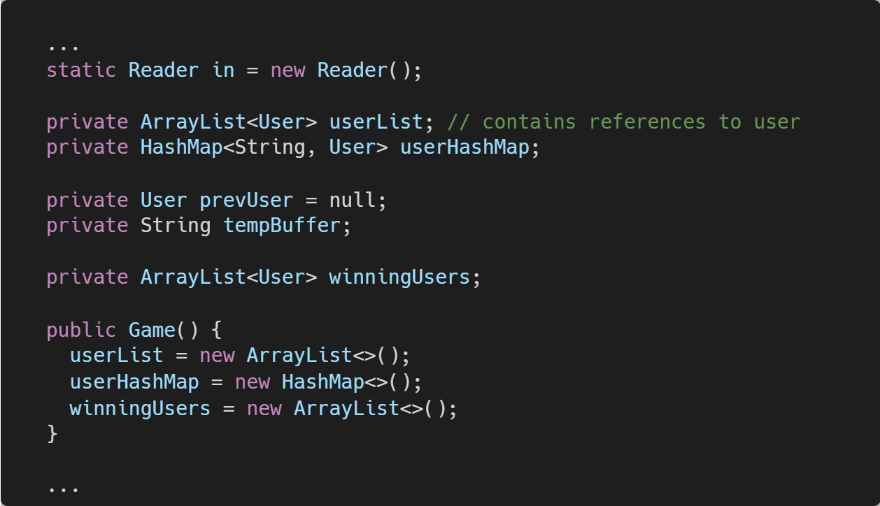
LET’S REVIEW SOME Strengths.
The code is organized into classes, each class has a specific purpose and is responsible for a specific part of the game logic.
Use of Enums to define the moves is a good practice for readability and maintainability.
The use of abstraction (Entity class) for different entities in the game provides a clean and extensible design.
Proper use of collections like ArrayList and HashMap to manage data structures efficiently.

Slide 14
What about weaknesses?
The 'runGame()' method is quite long and complex. It might be better to break it down into smaller methods to improve readability and maintainability.
There are some magic numbers in the code (e.g., 2, 3, 4, 5 for grid elements). It is better to use constants or Enums for better readability and maintainability.
The code lacks proper input validation and error handling. For example, there is no check for empty input or invalid input for the number of players, usernames, and moves.
The 'User' class has a high number of instance variables, making it harder to manage and understand. It might be better to refactor the class or use a different design pattern to reduce the complexity.
The 'printResults()' method has a sorting operation, which could be improved by using Java 8 Streams and lambda expressions for better readability.
Subclasses of Entity are not designed well, could be improved using interfaces

Slide 15
Code with the Most Room for Improvement
03

Slide 16
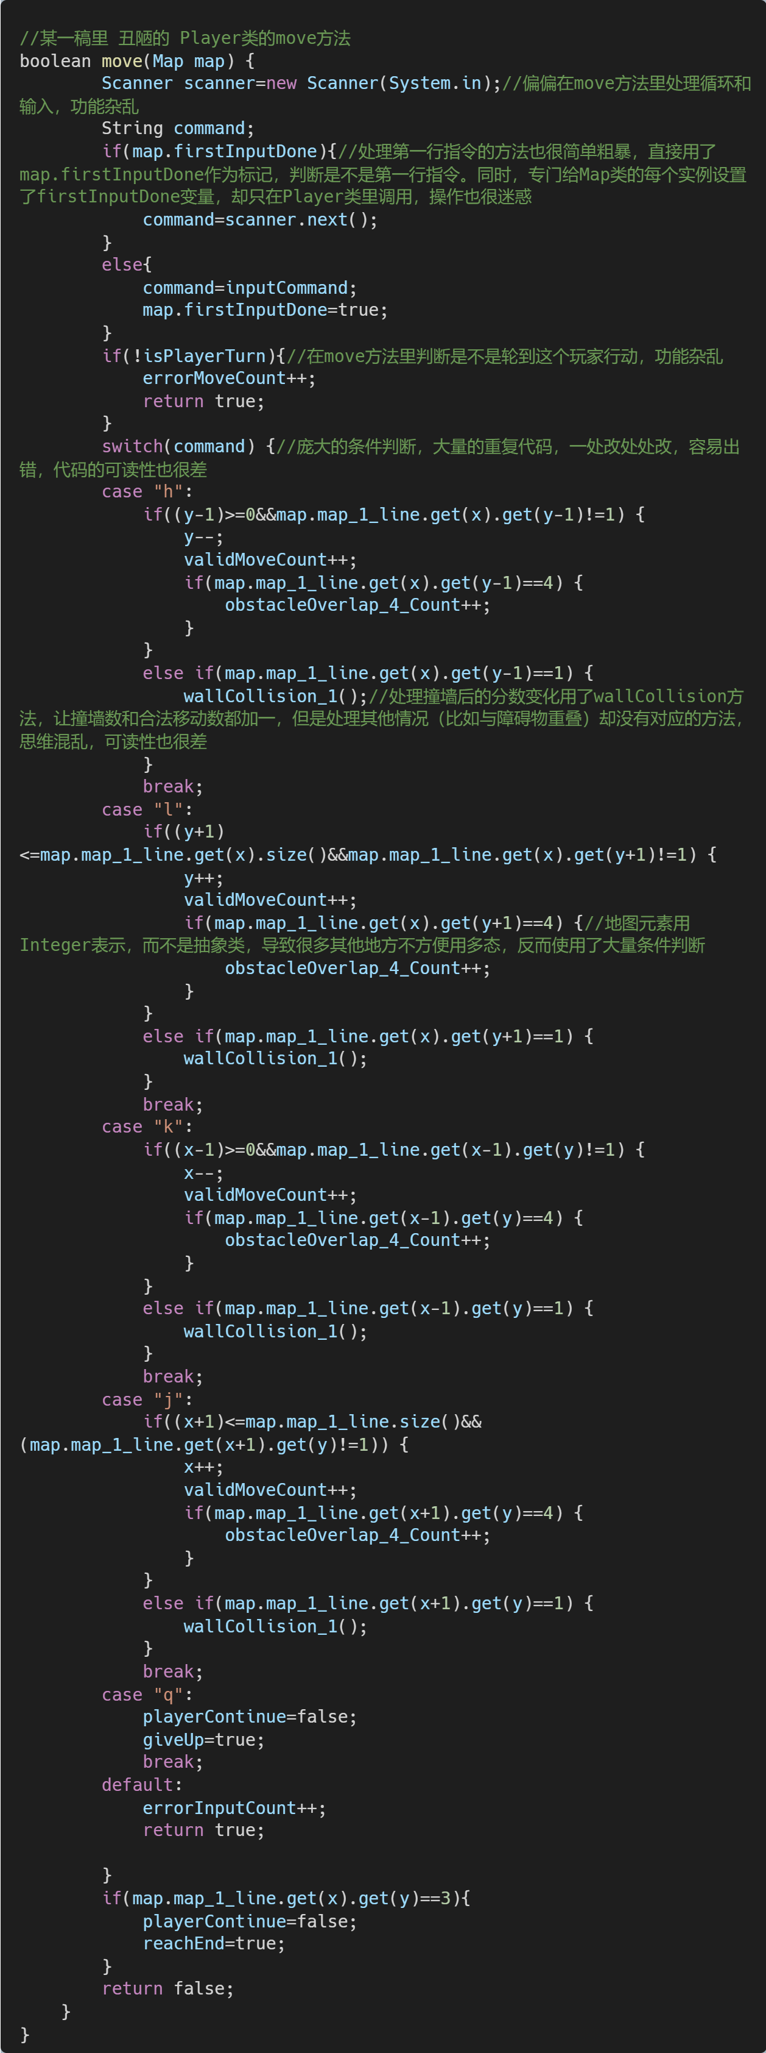
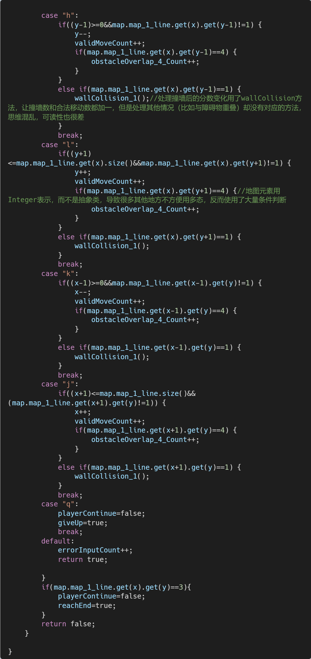

Slide 17
Analysis
Mixing responsibilities
Directly accessing other objects' state
Lack of abstraction
Code duplication
Encapsulate the game state
Improper input handling

Slide 18
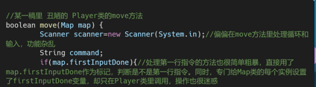
Mixing responsibility
The move method is responsible for user input, input validation, and game logic. This violates the Single Responsibility Principle. To improve this, separate these concerns into different methods or classes.

Slide 19
Directly accessing other objects' state
The method directly accesses and modifies the Map object's state, e.g., map.firstInputDone. Encapsulate the Map object's state and provide methods to interact with it, like map.isFirstInputDone() and map.setFirstInputDone(boolean).

Slide 20
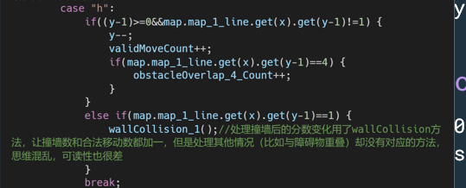
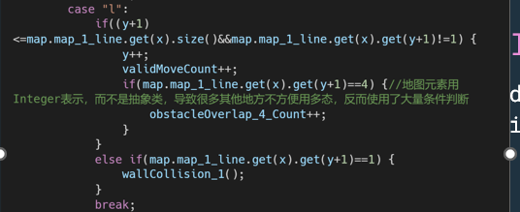
Lack of abstraction and Code Duplication
The code uses integers to represent map elements, making it harder to use polymorphism for better abstraction.
There is a lot of duplicated code in the switch statement. Create separate methods for each movement direction and reuse them.

Slide 21
Encapsulate the game state
Variables like errorMoveCount, validMoveCount, and obstacleOverlap_4_Count should be part of the game state object and not directly managed by the Player class.

Slide 22
Improper input handling
The method creates a new Scanner object each time it is called. This can cause issues when reading from System.in. Move the Scanner object to a higher level, like the main game loop, and pass the input to the move method as an argument.

Slide 23
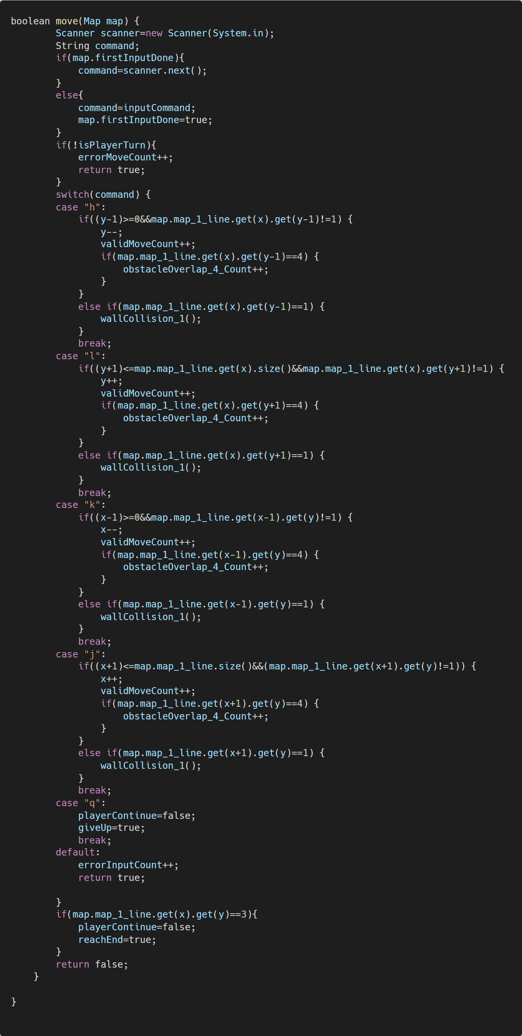
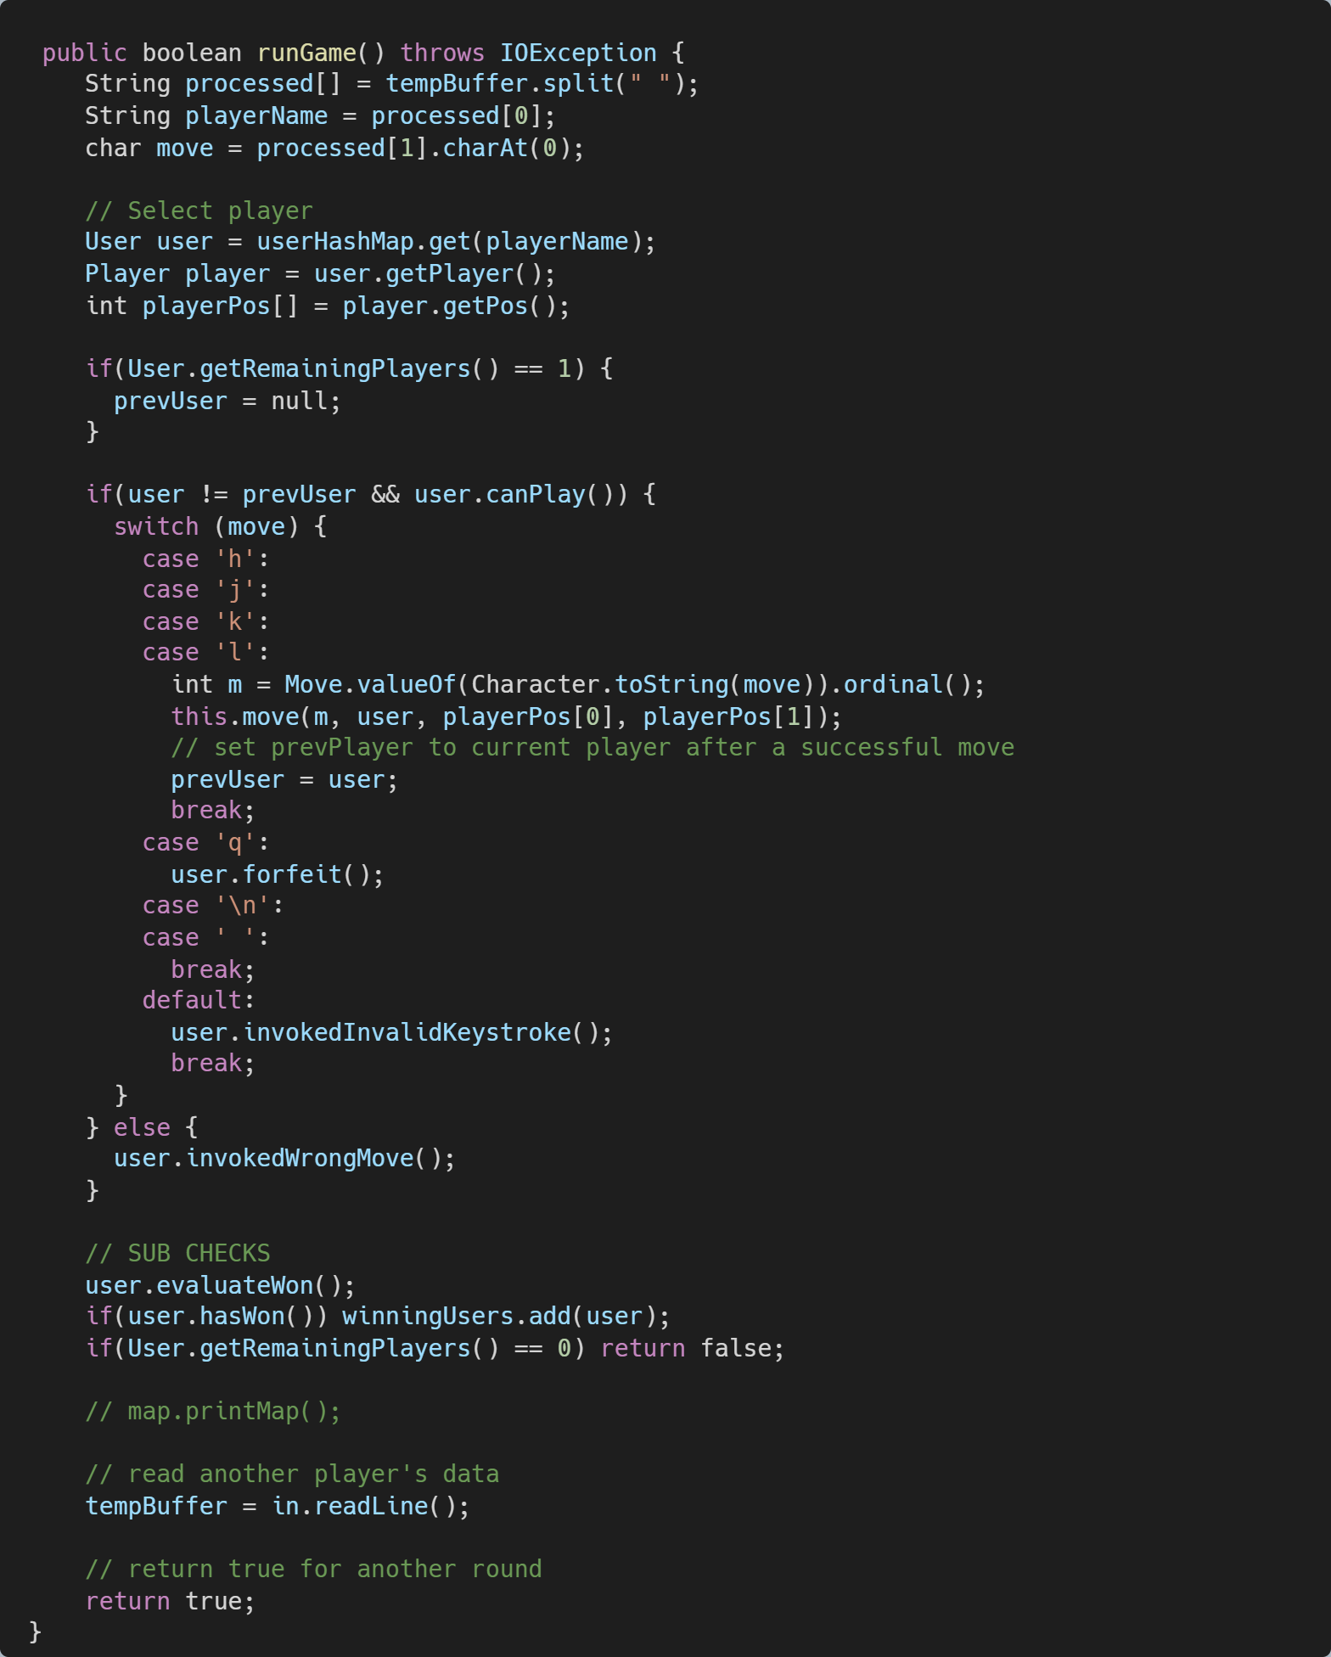
(4) Comparison

Slide 24
Lab[n] => Lab[n+1]
05

Slide 25
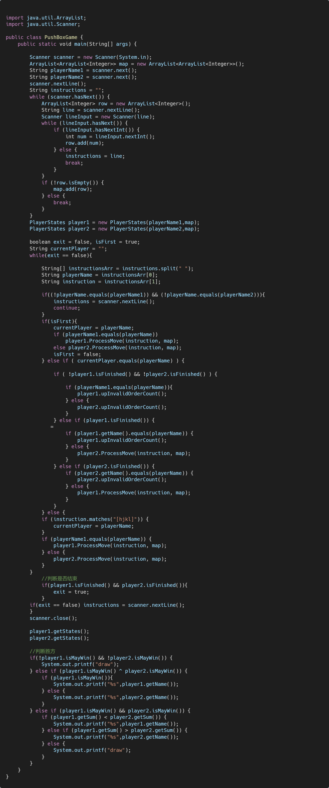
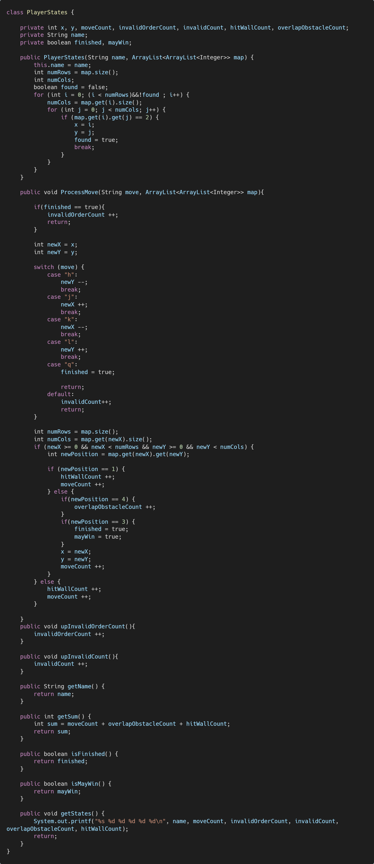
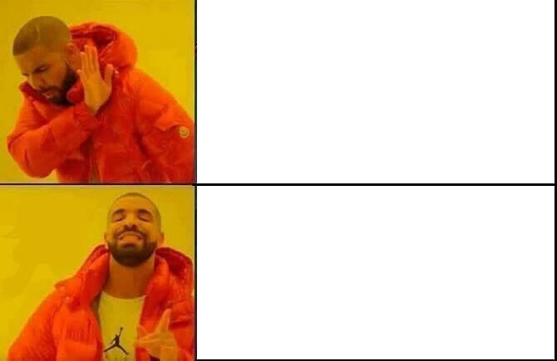
Lab[n] Before

Slide 26
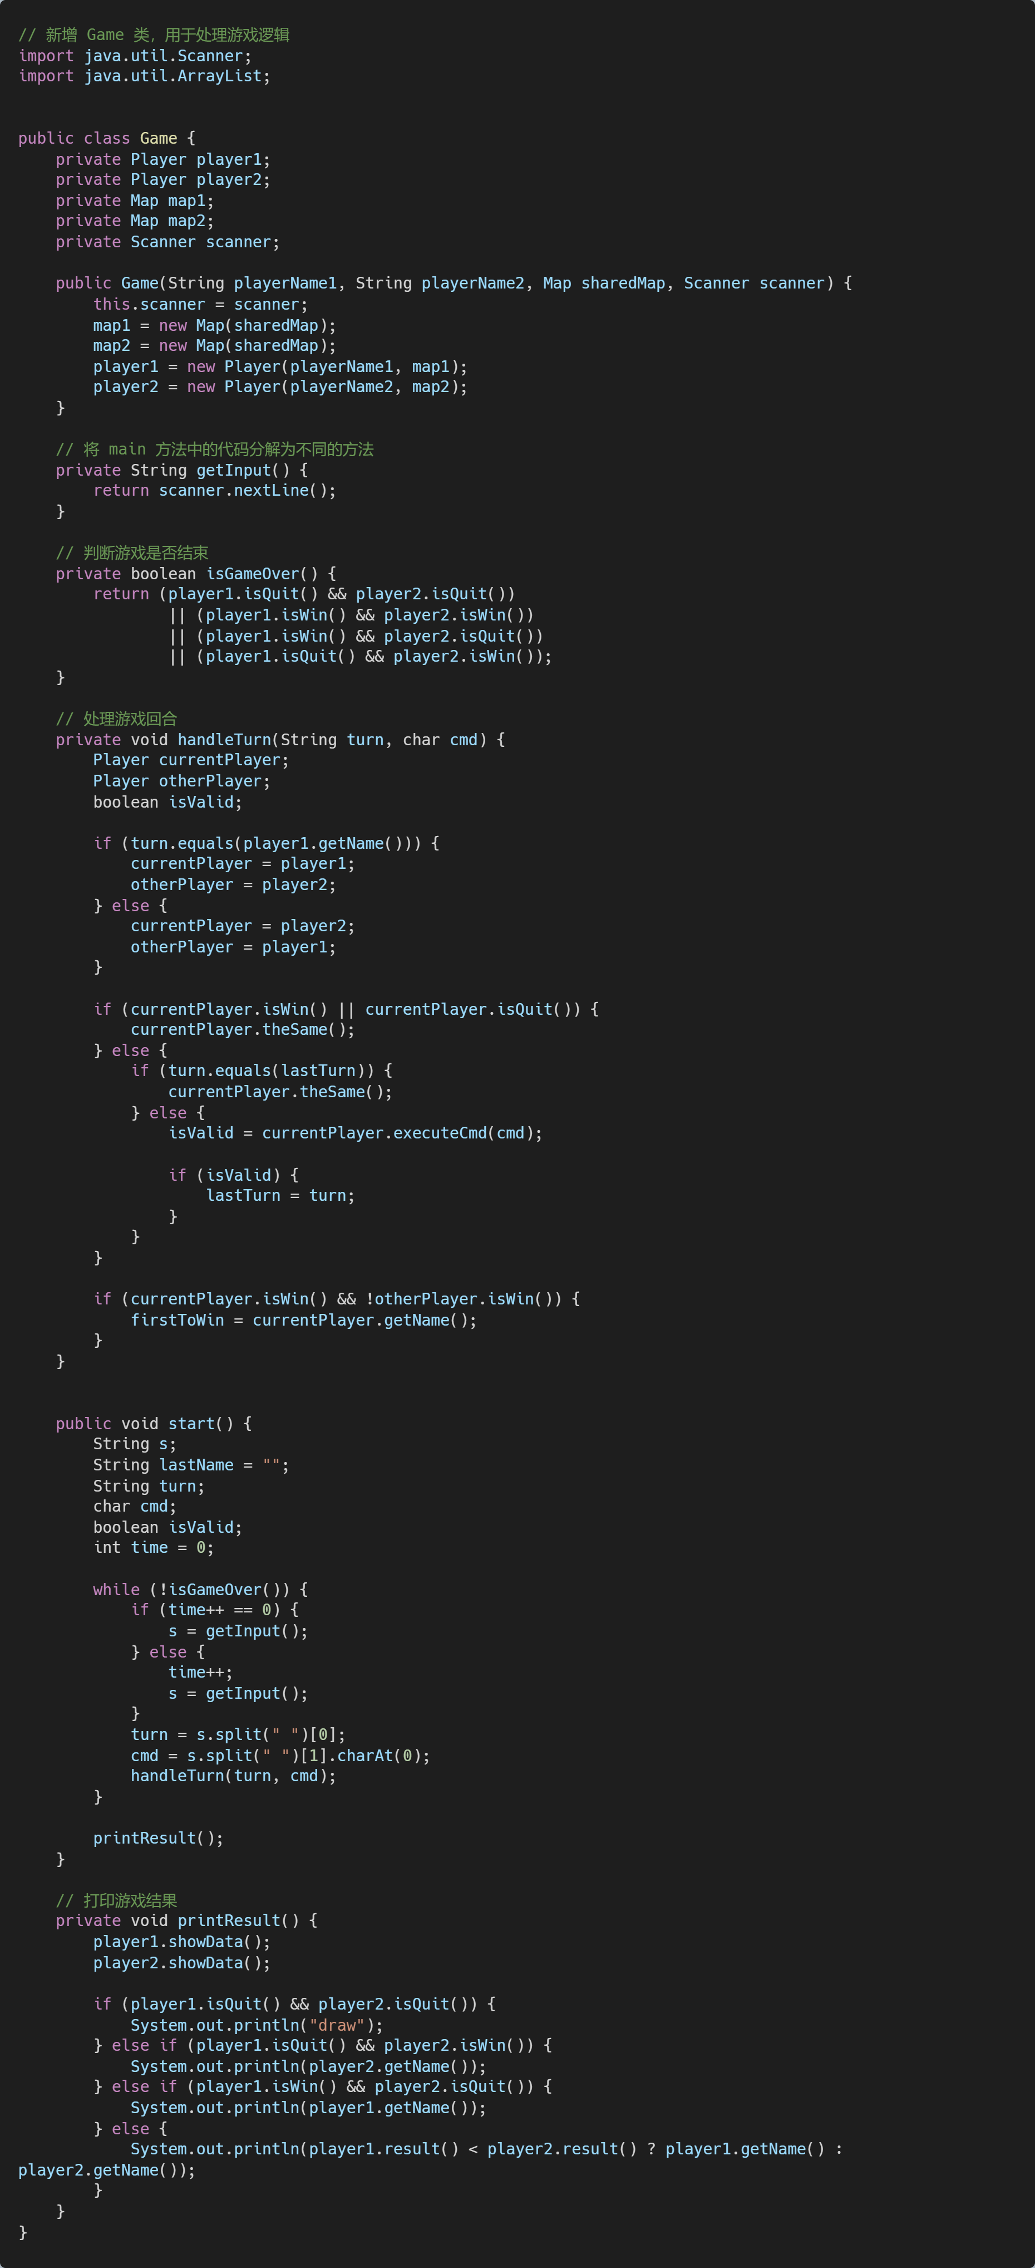
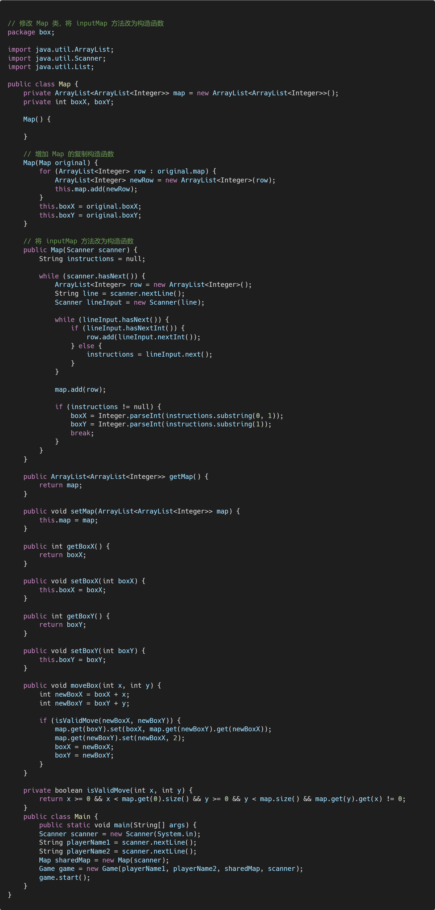
Lab[n+1] After
hello@mail.com
555-111-222
mydomain.com

Slide 27
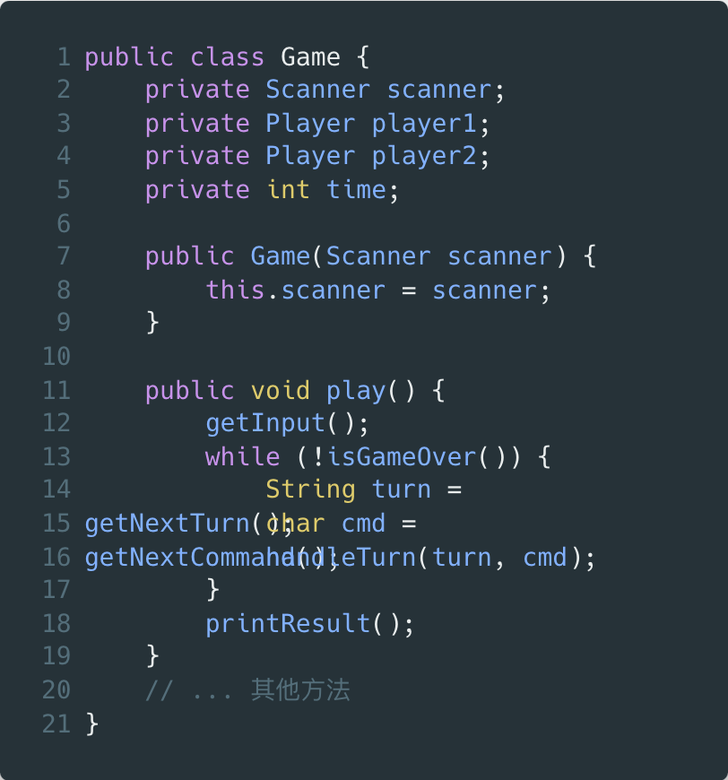
Improvements
新增 Game 类，负责处理游戏逻辑，使 Main 类的职责更加简单明确
将 main 方法中的代码分解为不同的方法，并将其移入 Game 类
修改了 Map 类
修改了 Player 类的属性和方法

Slide 28
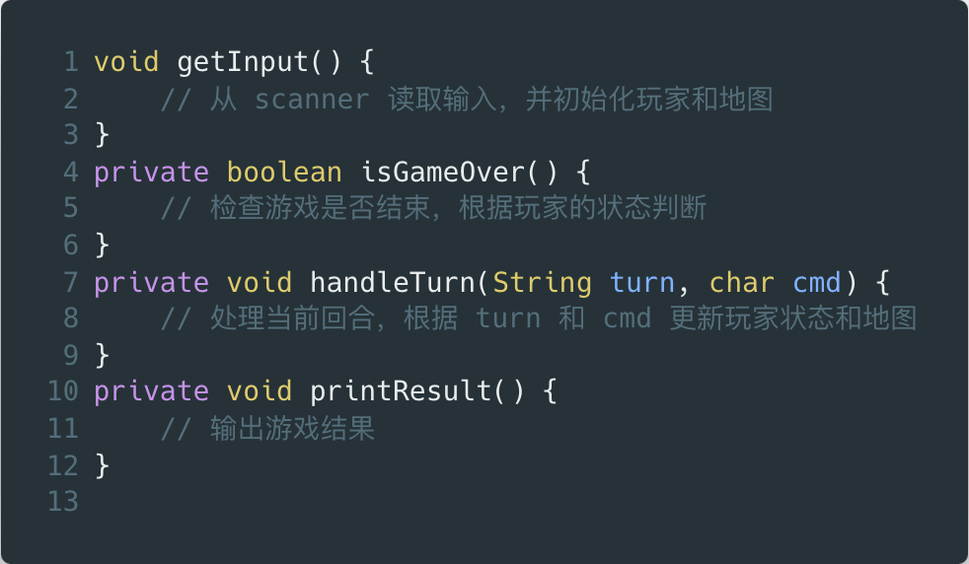
Improvements
新增 Game 类，负责处理游戏逻辑，使 Main 类的职责更加简单明确
将 main 方法中的代码分解为不同的方法，并将其移入 Game 类
修改了 Map 类
修改了 Player 类的属性和方法

Slide 29
Improvements
新增 Game 类，负责处理游戏逻辑，使 Main 类的职责更加简单明确
将 main 方法中的代码分解为不同的方法，并将其移入 Game 类
修改了 Map 类
修改了 Player 类的属性和方法

Slide 30
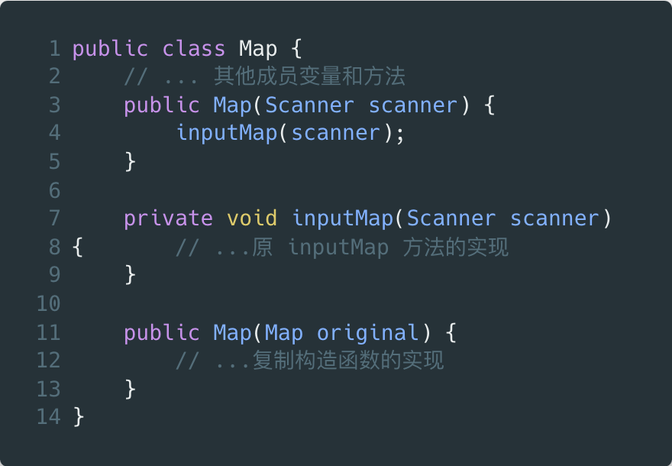
Improvements
新增 Game 类，负责处理游戏逻辑，使 Main 类的职责更加简单明确
将 main 方法中的代码分解为不同的方法，并将其移入 Game 类
修改了 Map 类
修改了 Player 类的属性和方法

Slide 31
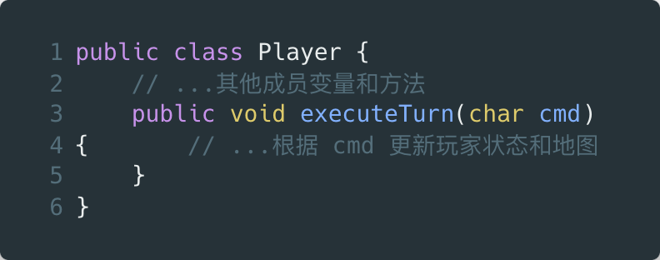
Improvements
新增 Game 类，负责处理游戏逻辑，使 Main 类的职责更加简单明确
将 main 方法中的代码分解为不同的方法，并将其移入 Game 类
修改了 Map 类
修改了 Player 类的属性和方法

Slide 32
(6) Q&A!

